Slide 1


Introduction to Shader development
h_da WS2020/21
Paul Nasdalack
info@paul-nasdalack.com
@littleBugHunter

Slide 2

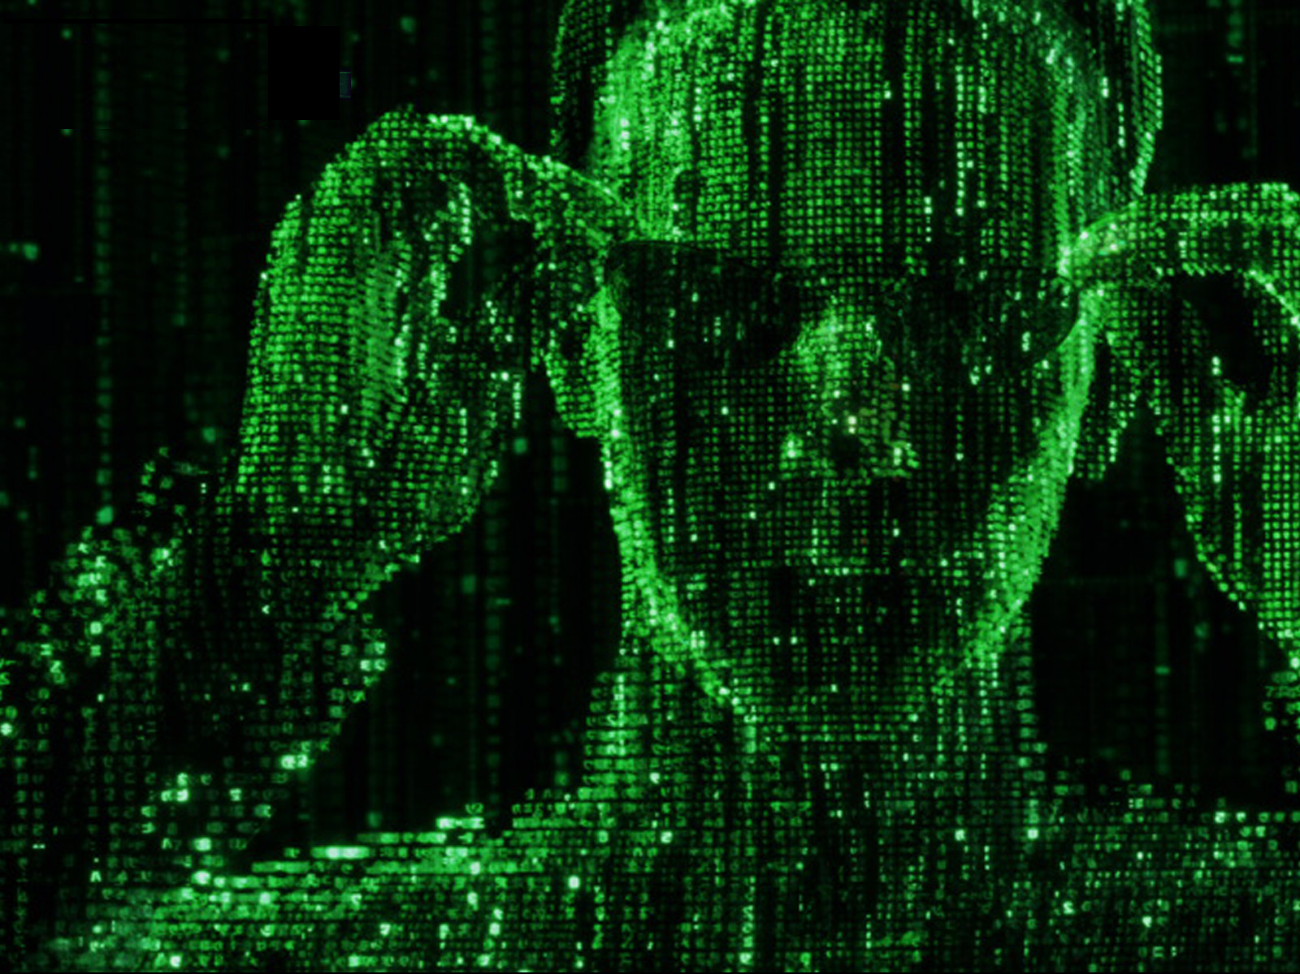
Vectors and Matrices

Slide 3
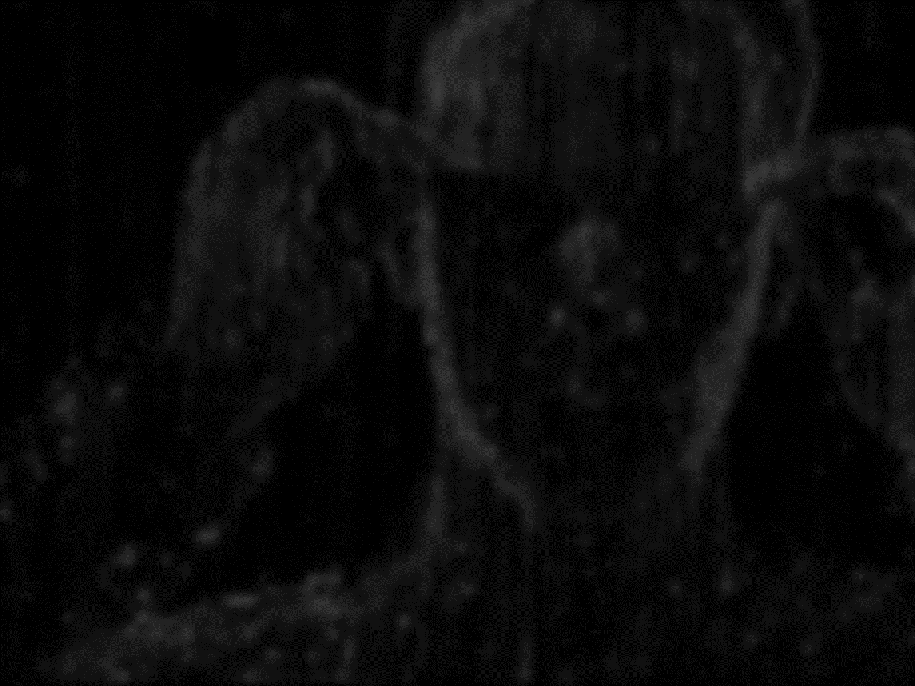
Vectors and Matrices

Slide 4
Vectors and Matrices
A vector space (also called a linear space) is a collection of objects called vectors, which may be added together andmultiplied ("scaled") by numbers, called scalars in this context. Scalars are often taken to be real numbers, but there are also vector spaces with scalar multiplication by complex numbers, rational numbers, or generally any field. The operations of vector addition and scalar multiplication must satisfy certain requirements, called axioms, listed below.
(https://en.wikipedia.org/wiki/Vector_space)

Slide 5
Vectors and Matrices
What are Vectors to us?

Slide 6
What are Vectors to us?
A Vector is:
Multiple numbers, that somehow belong together
Popular Vectors are:
Positions (2 or 3 Numbers XY[Z])
Colors (3 or 4 Numbers RGB[A])
Directions (2 or 3 Numbers XY[Z])
Basically everything in Shaders is represented by a Vector or a Scalar

Slide 7
What are Vectors to us?
Scalar?

Slide 8
What are Vectors to us?
Scalar?
Just a fancy term for single Number

Slide 9
What are Vectors to us?
What can we do with Vectors?

Slide 10
What can we do with Vectors?
Add/Substract
Multiply
Dot product
Cross product
Scalar product
Divide???

Slide 11
Add/Substract
3
2
4
1
5
2
4
7
6

Slide 12
Add/Substract
3
2
4
1
5
2
4
7
6

Slide 13
What are Vectors to us?
Vector
HLSL/CG Syntax:
float a = 3.41; //normal scalar
float3 b = float3(0.2,0.32,0.4) //vector

Slide 14
Add/Substract
HLSL/CG Syntax:
a+b
a-b

Slide 15
Add/Substract
What can we do with Add/Substract?

Slide 16
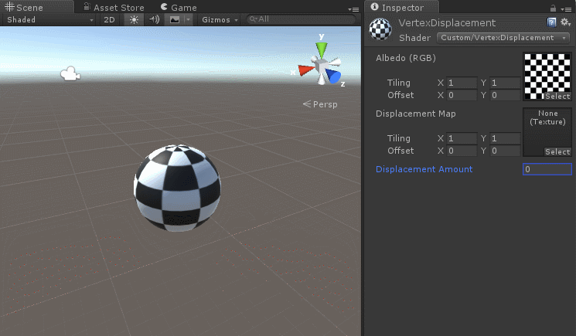
What can we do with Add/Substract?
Move Positions around (aka Vertex Displacement)

Slide 17
What can we do with Add/Substract?
Add Colors together
Red
(1,0,0)
Green
(0,1,0)
Yellow
(1,1,0)
+
=

Slide 18
What can we do with Add/Substract?
Add Colors together
Purple
(0.4,0,0.8)
Orange
(1,0.6,0)
Rose-ish
(1.4,1.6,0.8)
+
=

Slide 19
What can we do with Add/Substract?
Add Colors together
Purple
(0.4,0,0.8)
Orange
(1,0.6,0)
Rose-ish
(1.4,1.6,0.8)
+
=
???

Slide 20
What can we do with Add/Substract?
Add Colors together
Purple
(0.4,0,0.8)
Orange
(1,0.6,0)
Rose-ish
(1.4,1.6,0.8)
+
=
HDR!!!

Slide 21
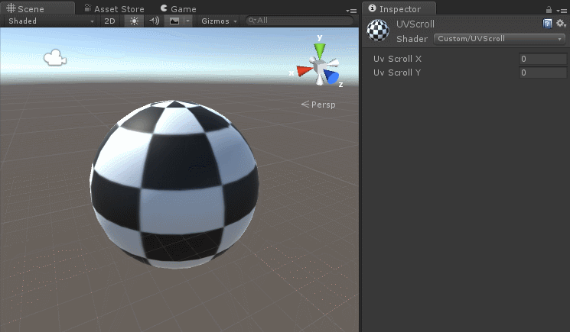
What can we do with Add/Substract?
Scroll UVs around

Slide 22
Multiplication (Scalar Product)
1
5
2
3
15
6
3
*

Slide 23
Multiplication (Scalar Product)
3
3
3
*
1
5
2
3
15
6
*
*

Slide 24
Multiplication (Scalar Product)
2
4
5
*
1
5
2
2
20
10
*
*
DISCLAIMER!
This is not very mathematical, but it‘s just too darn useful, so we‘ve built it into Shaders anyway

Slide 25
Multiplication (Scalar Product)
HLSL/CG Syntax:
a*b
3*b

Slide 26
Multiplication (Scalar Product)
What can we do with Scalar Products?

Slide 27
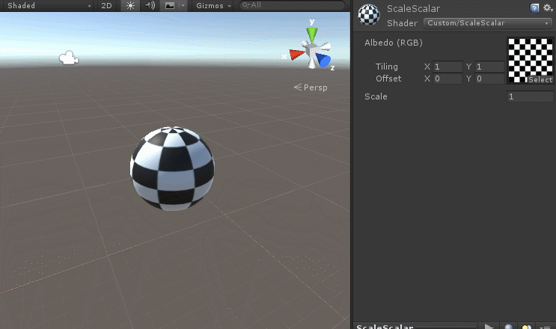
What can we do with Scalar Products?
Scale things! (using a Scalar)

Slide 28

What can we do with Scalar Products?
Scale things! (using a Vector)

Slide 29
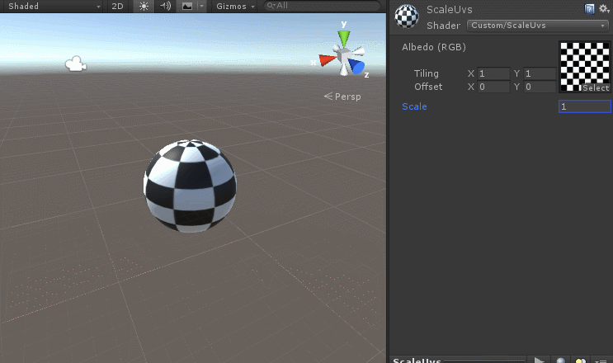
What can we do with Scalar Products?
Scale things! (UVs)

Slide 30
What can we do with Scalar Products?
Multiply Colors
Pink
(1,0,1)
Light Blue
(0.5,0.5,1)
Deep Purple
(0.5,0,1)
*
=

Slide 31
What can we do with Scalar Products?
Multiply Colors
Green
(0,1,0)
Red
(1,0,0)
Black
(0,0,0)
*
=

Slide 32
What can we do with Scalar Products?
Multiply Colors
Orange
(1,0.5,0)
Dark Orange
(0.5, 0.25, 0)
0.5
*
=

Slide 33
What can we do with Scalar Products?
Multiply Colors
Orange
(1,0.5,0)
HDR Yellow
(3, 1.5, 0)
3
*
=

Slide 34
Multiplication (Dot Product) (aka: the proper way to multiply Vectors)
3
2
4
1
5
2
21

Slide 35
Multiplication (Dot Product) (aka: the proper way to multiply Vectors)
3
2
4
1
5
2
21?

Slide 36
Multiplication (Dot Product) (aka: the proper way to multiply Vectors)
3
2
4
1
5
2
(3*1)+(2*5)+(4*2)

Slide 37
Multiplication (Dot Product) (aka: the proper way to multiply Vectors)
HLSL/CG Syntax:
dot(a, b);

Slide 38
Multiplication (Dot Product) (aka: the proper way to multiply Vectors)
What can we do with Dot Products?

Slide 39
What can we do with Dot Products?
Tell the angle between two (normalized) Vectors
A
0
B

Slide 40
What can we do with Dot Products?
Tell the angle between two (normalized) Vectors
A
-1
B

Slide 41
What can we do with Dot Products?
Tell the angle between two (normalized) Vectors
A
B
1

Slide 42
What can we do with Dot Products?
Normalized Vector?
A Vector with a length of 1 (usually directional Vectors are normalized)

Slide 43
What can we do with Dot Products?
Normalized Vector?
HLSL/CG Syntax:
normalize(a);

Slide 44
What can we do with Dot Products?
Back to Dot Products!

Slide 45
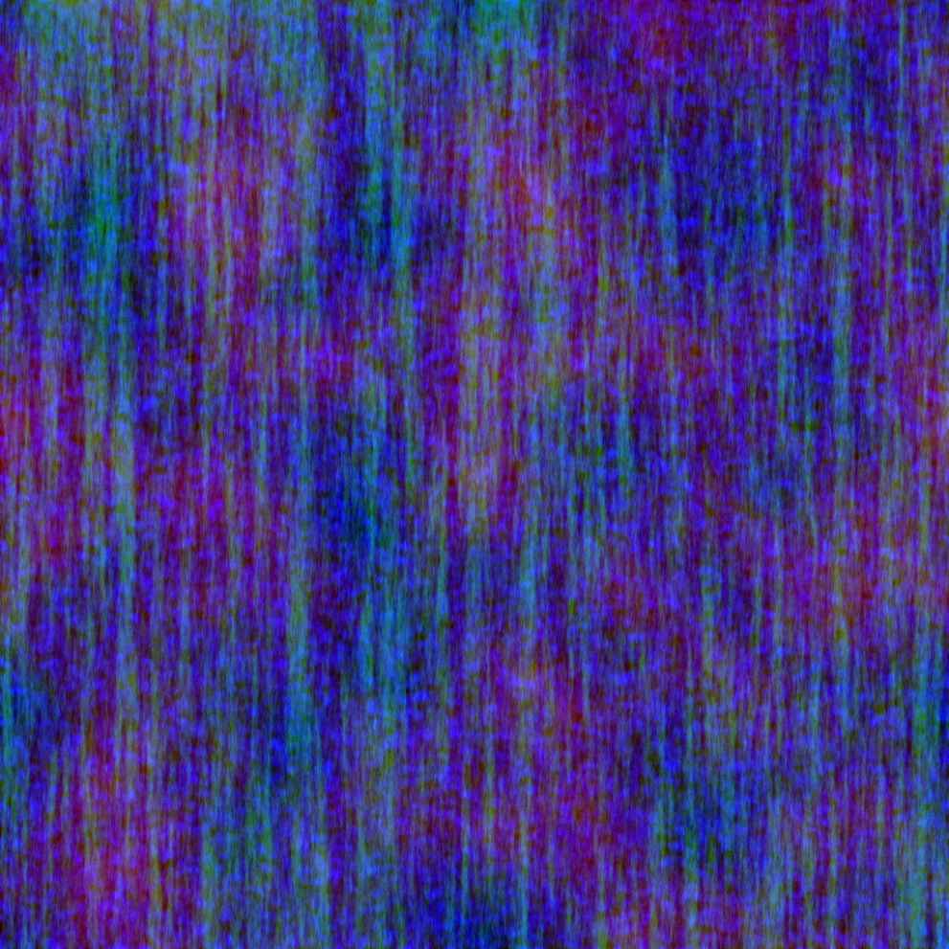
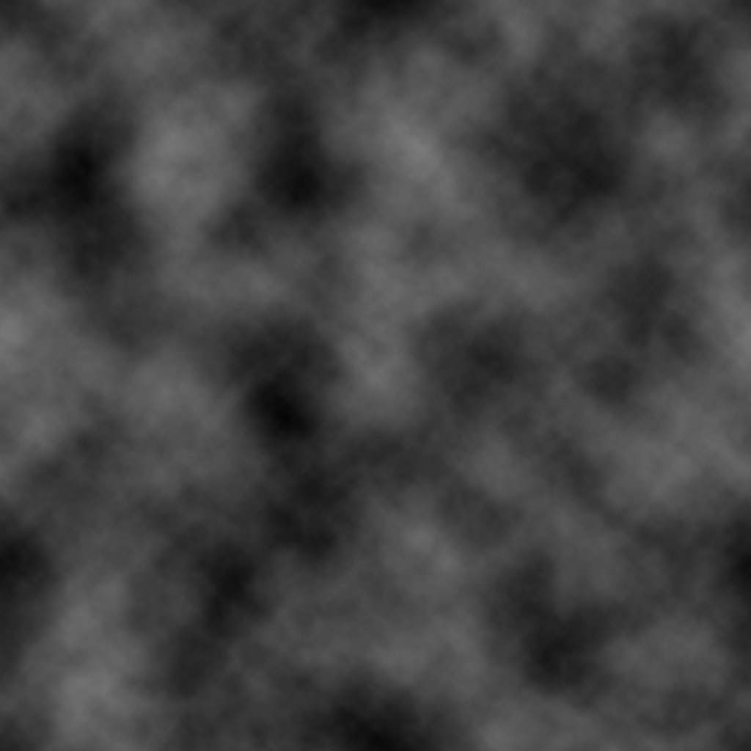
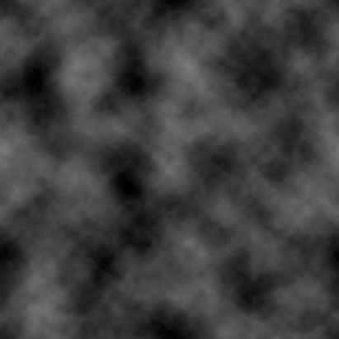
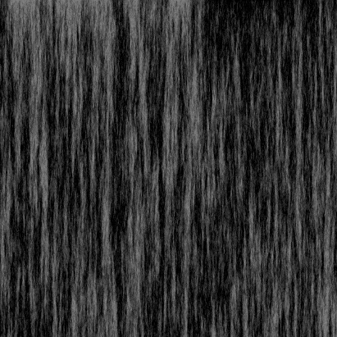
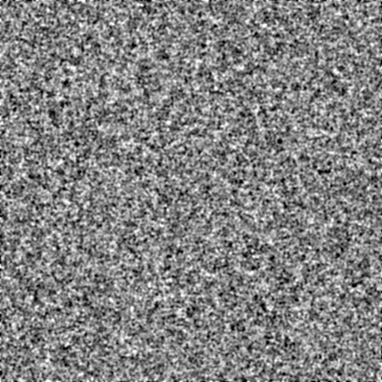
What can we do with Dot Products?
Colormask Textures
Red
(1,0,0)

Slide 46
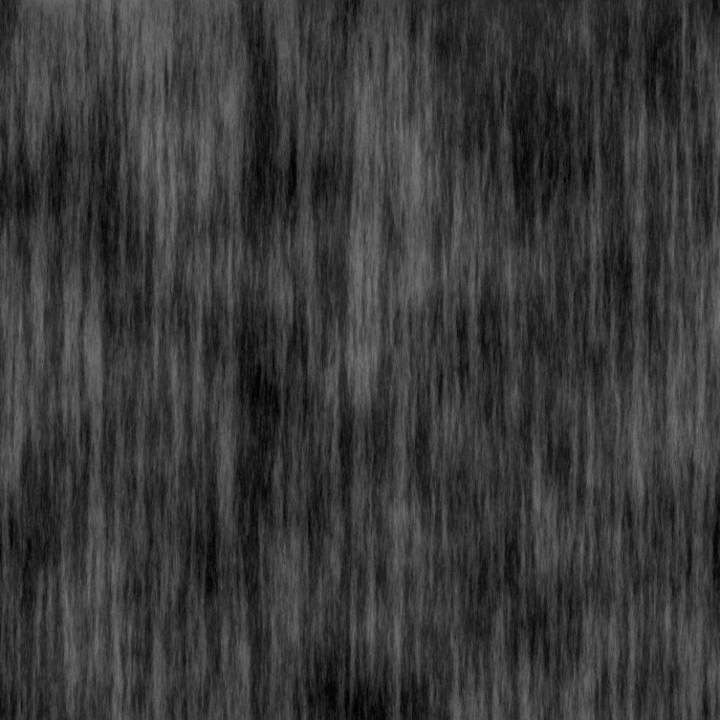
What can we do with Dot Products?
Colormask Textures
DarkYellow
(0.5,0.5,0)

Slide 47
Multiplication (Cross Product)
1
-7
1
5
2
4
-30
1
37

Slide 48
Multiplication (Cross Product)
1
-7
1
5
2
4
-7*4-1*2
?
?

Slide 49
Multiplication (Cross Product)
1
-7
1
5
2
4
-7*4-1*2
1*5-1*4
?
1
-7
1
5
2
4

Slide 50
Multiplication (Cross Product)
1
-7
1
5
2
4
-7*4-1*2
1*5-1*4
1*2- -7*5

Slide 51
Multiplication (Cross Product)
1
-7
1
5
2
4
-30
1
37

Slide 52
Multiplication (Cross Product)
HLSL/CG Syntax:
cross(a, b);

Slide 53
Multiplication (Cross Product)
What can we do with Cross Products?

Slide 54
What can we do with Cross Products?
Encode the Bitangent
Normal
Tangent

Slide 55
What can we do with Cross Products?
Encode the Bitangent
Normal
Normal X Tangent * Tangent.w (Bitangent)
Tangent

Slide 56
Division?
3
2
4
1
5
2
/
?
DISCLAIMER!
This is not very mathematical, but it‘s just too darn useful, so we‘ve built it into Shaders anyway

Slide 57
Division
3
2
4
1
5
2
3
0.40.2
/

Slide 58
Division
3
2
4
/
1
5
2
3
0.40.2
/
/
DISCLAIMER!
This is not very mathematical, but it‘s just too darn useful, so we‘ve built it into Shaders anyway

Slide 59
Division
HLSL/CG Syntax:
a/b;

Slide 60
Swizzle!!!

Slide 61
Swizzle
HLSL/CG Syntax:
a.xyz = b.xxy;
a.rgb = b.aaa;
a.rgba = b.xyzw;

Slide 62
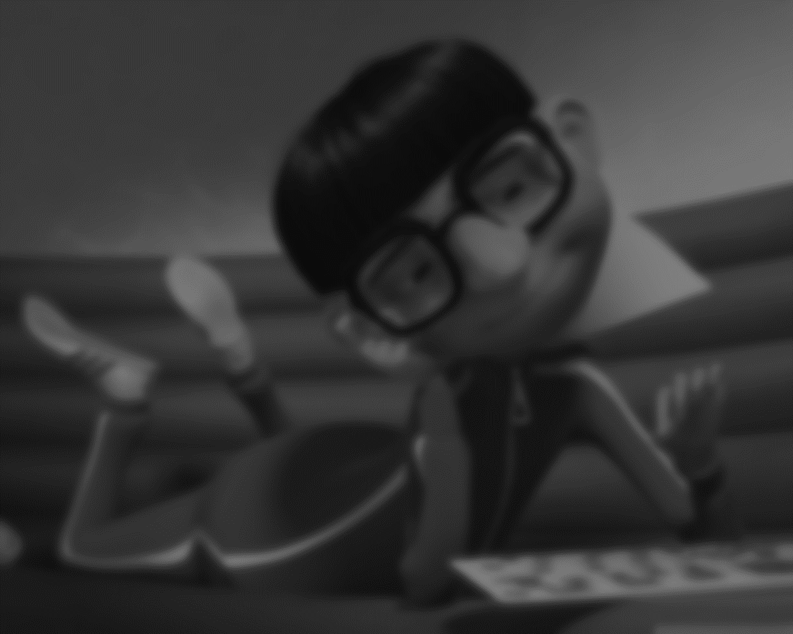

Vectors and Matrices

Slide 63
Matrices
The Matrix is a 1999 American-Australian science fiction action film written and directed by The Wachowskis, starring Keanu Reeves, Laurence Fishburne, Carrie-Anne Moss, Hugo Weaving, and Joe Pantoliano. It depicts a dystopian future in which reality as perceived by most humans is actually a simulated reality called "the Matrix", created by sentient machines to subdue the human population, while their bodies' heat and electrical activity are used as an energy source. Computer programmer "Neo" learns this truth and is drawn into a rebellion against the machines, which involves other people who have been freed from the "dream world".
(https://en.wikipedia.org/wiki/The_Matrix)

Slide 64
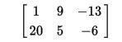
Matrices
In mathematics, a matrix (plural matrices) is a rectangular array^{[1]} of numbers, symbols, or expressions, arranged in rows and columns.^{[2][3]} For example, the dimensions of matrix (1) are 2 × 3 (read "two by three"), because there are two rows and three columns.
(https://en.wikipedia.org/wiki/Matrix_(mathematics))

Slide 65
Matrices
Matrices come in all kinds of sizes
3x3 Matrix
4x4 Matrix
4x3 Matrix
3x4 Matrix
2x2 Matrix

Slide 66
Matrices
HLSL/CG Syntax:
float3x3 mat = {1,2,3,1,4,2,3,1,2};

Slide 67
Matrices
What can we do with Matrices?

Slide 68
What can we do with Matrices?
Transform Positions
Move
Rotate
Scale
Perspectively Distort Positions

Slide 69
What can we do with Matrices?
Multiply them with other Matrices
Multiply them with Vectors

Slide 70
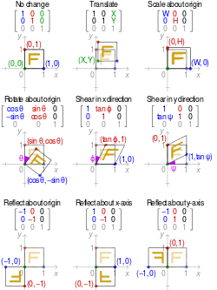
How does it work?
Transformation Matrices
Multiply a Position with the Matrix

Slide 71
Matrices
HLSL/CG Syntax:
mul(matA, vecB);

Slide 72
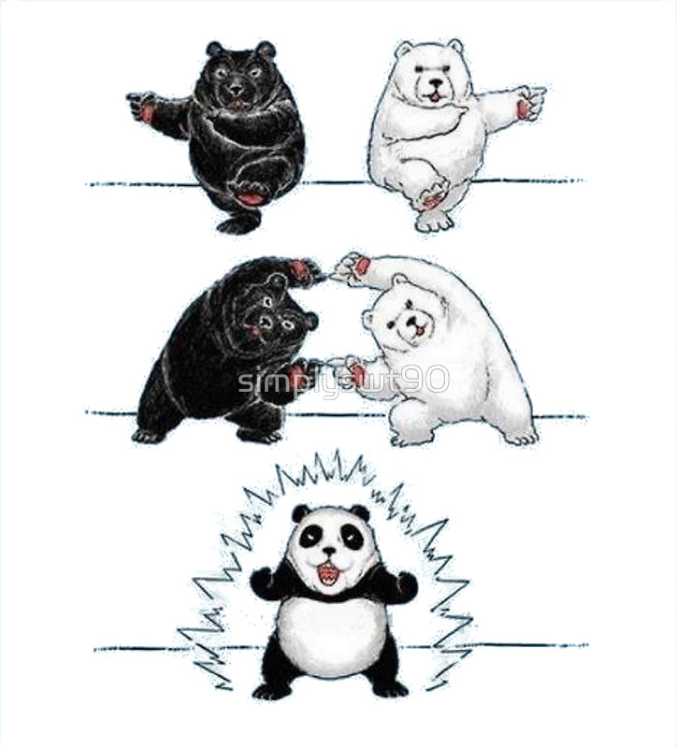
How does it work?
Multiply two matrices to combine their effects

Slide 73
Matrices
HLSL/CG Syntax:
matC = mul(matA, matB);
vecA = mul(matB, vecA);
vecA = mul(matA, vecA);
//multiplying with matC is the same as
//first multiplying MatB and then MatA
vecB = mul(matC, vecB);

Slide 74
Popular Matrices (in Shaders)
Model/World Matrix
Moves the model to its position
View/Camera Matrix
Moves the „World“ in front of the camera
Projection Matrix
Distorts the world perspectively
MVP Matrix
all the above multiplied together

Slide 75
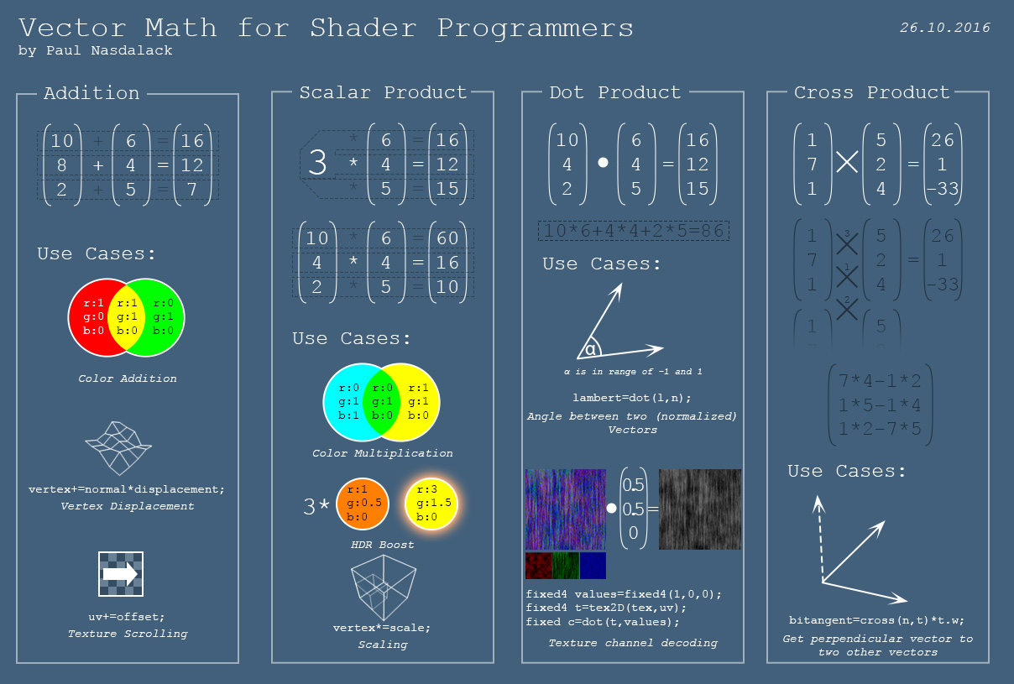
Cheat Sheet!
http://bit.ly/2dQzwvD

